Slide 1

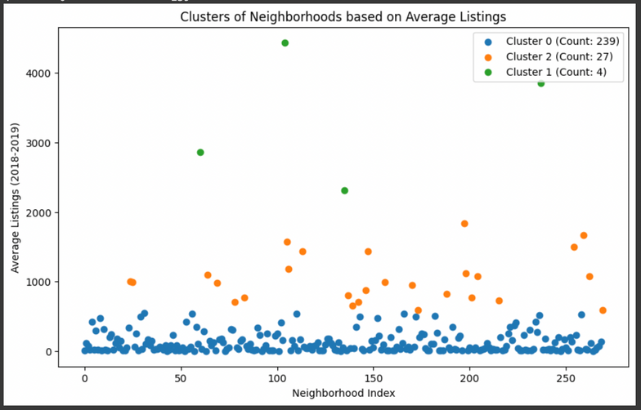
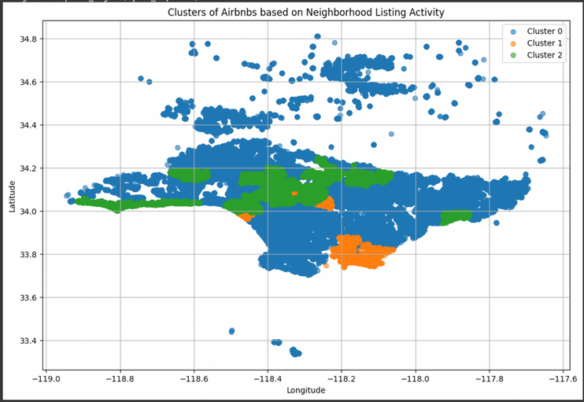
How has the AirBnB Market in LA Changed after COVID?
Clustering Methodology:
Extracted Month and Year from the Scrape File column to enhance temporal analysis.
Identified missing values in the neighbourhood column, where some listings had NaN values in earlier months but valid entries later.
Found that NaN values in the neighbourhood column accounted for ~17% of the data, leading to the decision to drop these rows as part of the data cleaning process.
Grouped data by key attributes (id, date, year, month, host_id, neighbourhood, neighbourhood_group, latitude, longitude, room_type) to compute:Number of listings, Average price, Average minimum nights, Average number of reviews, Average reviews per month,Average availability (365 days)
Aggregated unique listing counts per neighbourhood per year to analyze long-term trends.
Created clusters based on the average number of listings in 2018 and 2019, using K-Means clustering (3 clusters).
-> Focused on Clusters 0 and 2 for trend analysis, as they represented the majority of the data.
By Shreya & Anh Tuyet To

Slide 2
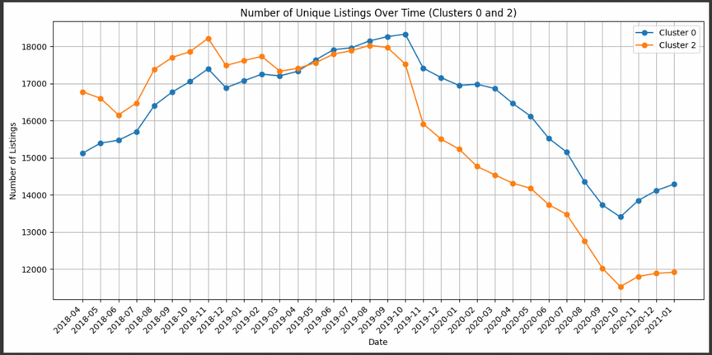
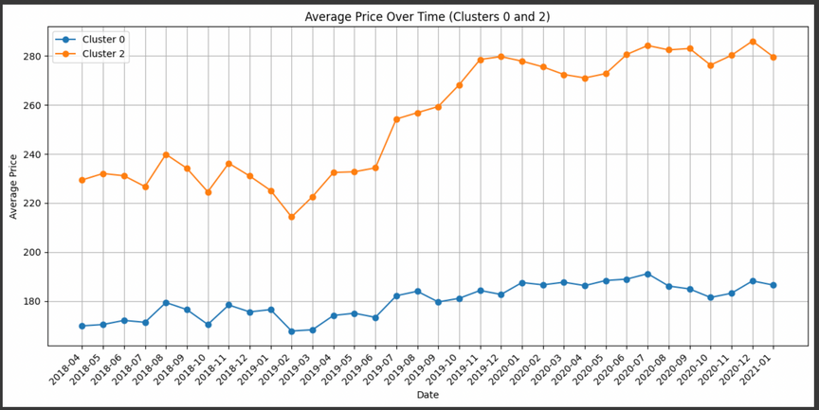
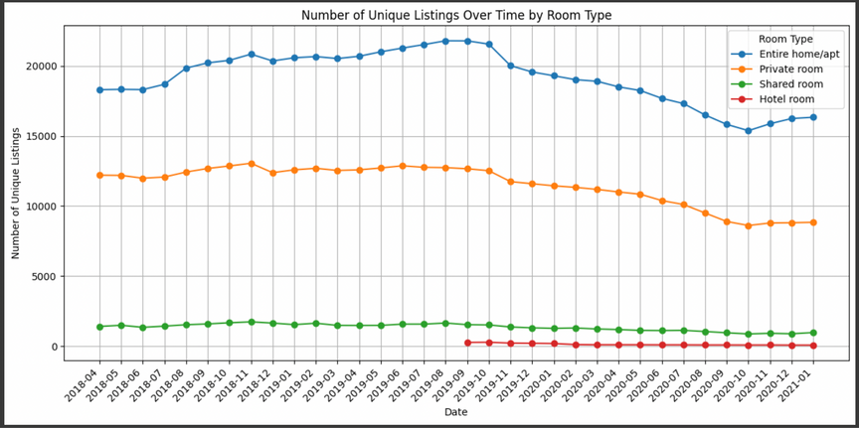
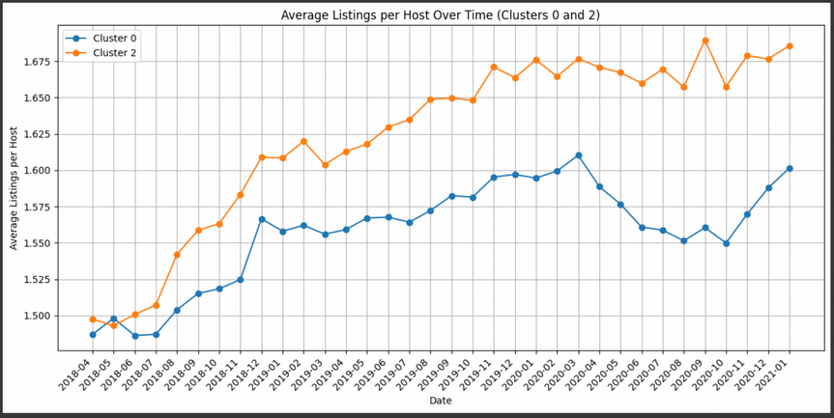
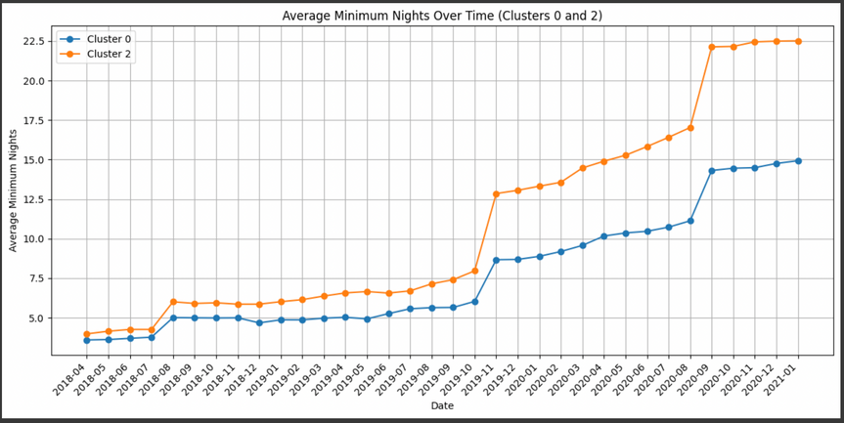
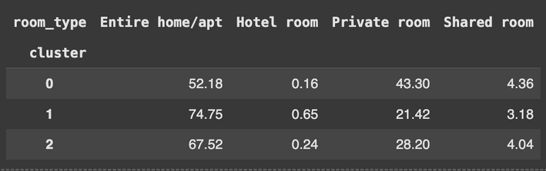
Figure 1: Number of Unique Listings OverTime
Figure 3: Average Price Over Time
Figure 2: Number of Unique Listings by Room Type
Figure 4: Average Listings per Host Over Time
Figure 5: Average Minimum Nights Overtime:
Table 1: Distribution of Room Types Across Clusters(%)

Slide 3
Figure 1: Unique listings declined in late 2019 due to stricter LA regulations, with a sharper drop in March 2020 due to COVID-19 travel restrictions. Listings stabilized by late 2020 as travel resumed.
Figure 2: Room types (entire homes, private rooms, shared spaces) followed a similar trend, declining during the pandemic and stabilizing by late 2020, with shared rooms and hotels excluded due to their low share (Table 1).
Figure 3: Cluster 0 (lower-priced listings) remained stable, while Cluster 2 (higher-priced listings) saw a sharp price increase from mid-2019, peaking in mid-2020 and stabilizing at higher levels.
Figure 4: Host listings grew steadily until March 2020, with Cluster 0 declining sharply and Cluster 2 recovering faster by mid-2020 due to long-term rental shifts.
Figure 5: Minimum night requirements spiked in November 2019 with LA's ordinance and again in early 2020, stabilizing at higher levels by late 2020 due to pandemic and regulatory impacts.
In summary:
While the COVID-19 pandemic negatively impacted the Airbnb market in LA, the effects were not as severe as expected.
The market began to recover post-pandemic, driven by a resurgence in travel demand after a long period of quarantine.
Long-term challenges:
increased competition
low switching costs for both hosts and guests
growing complexity of policies

